Slide 1

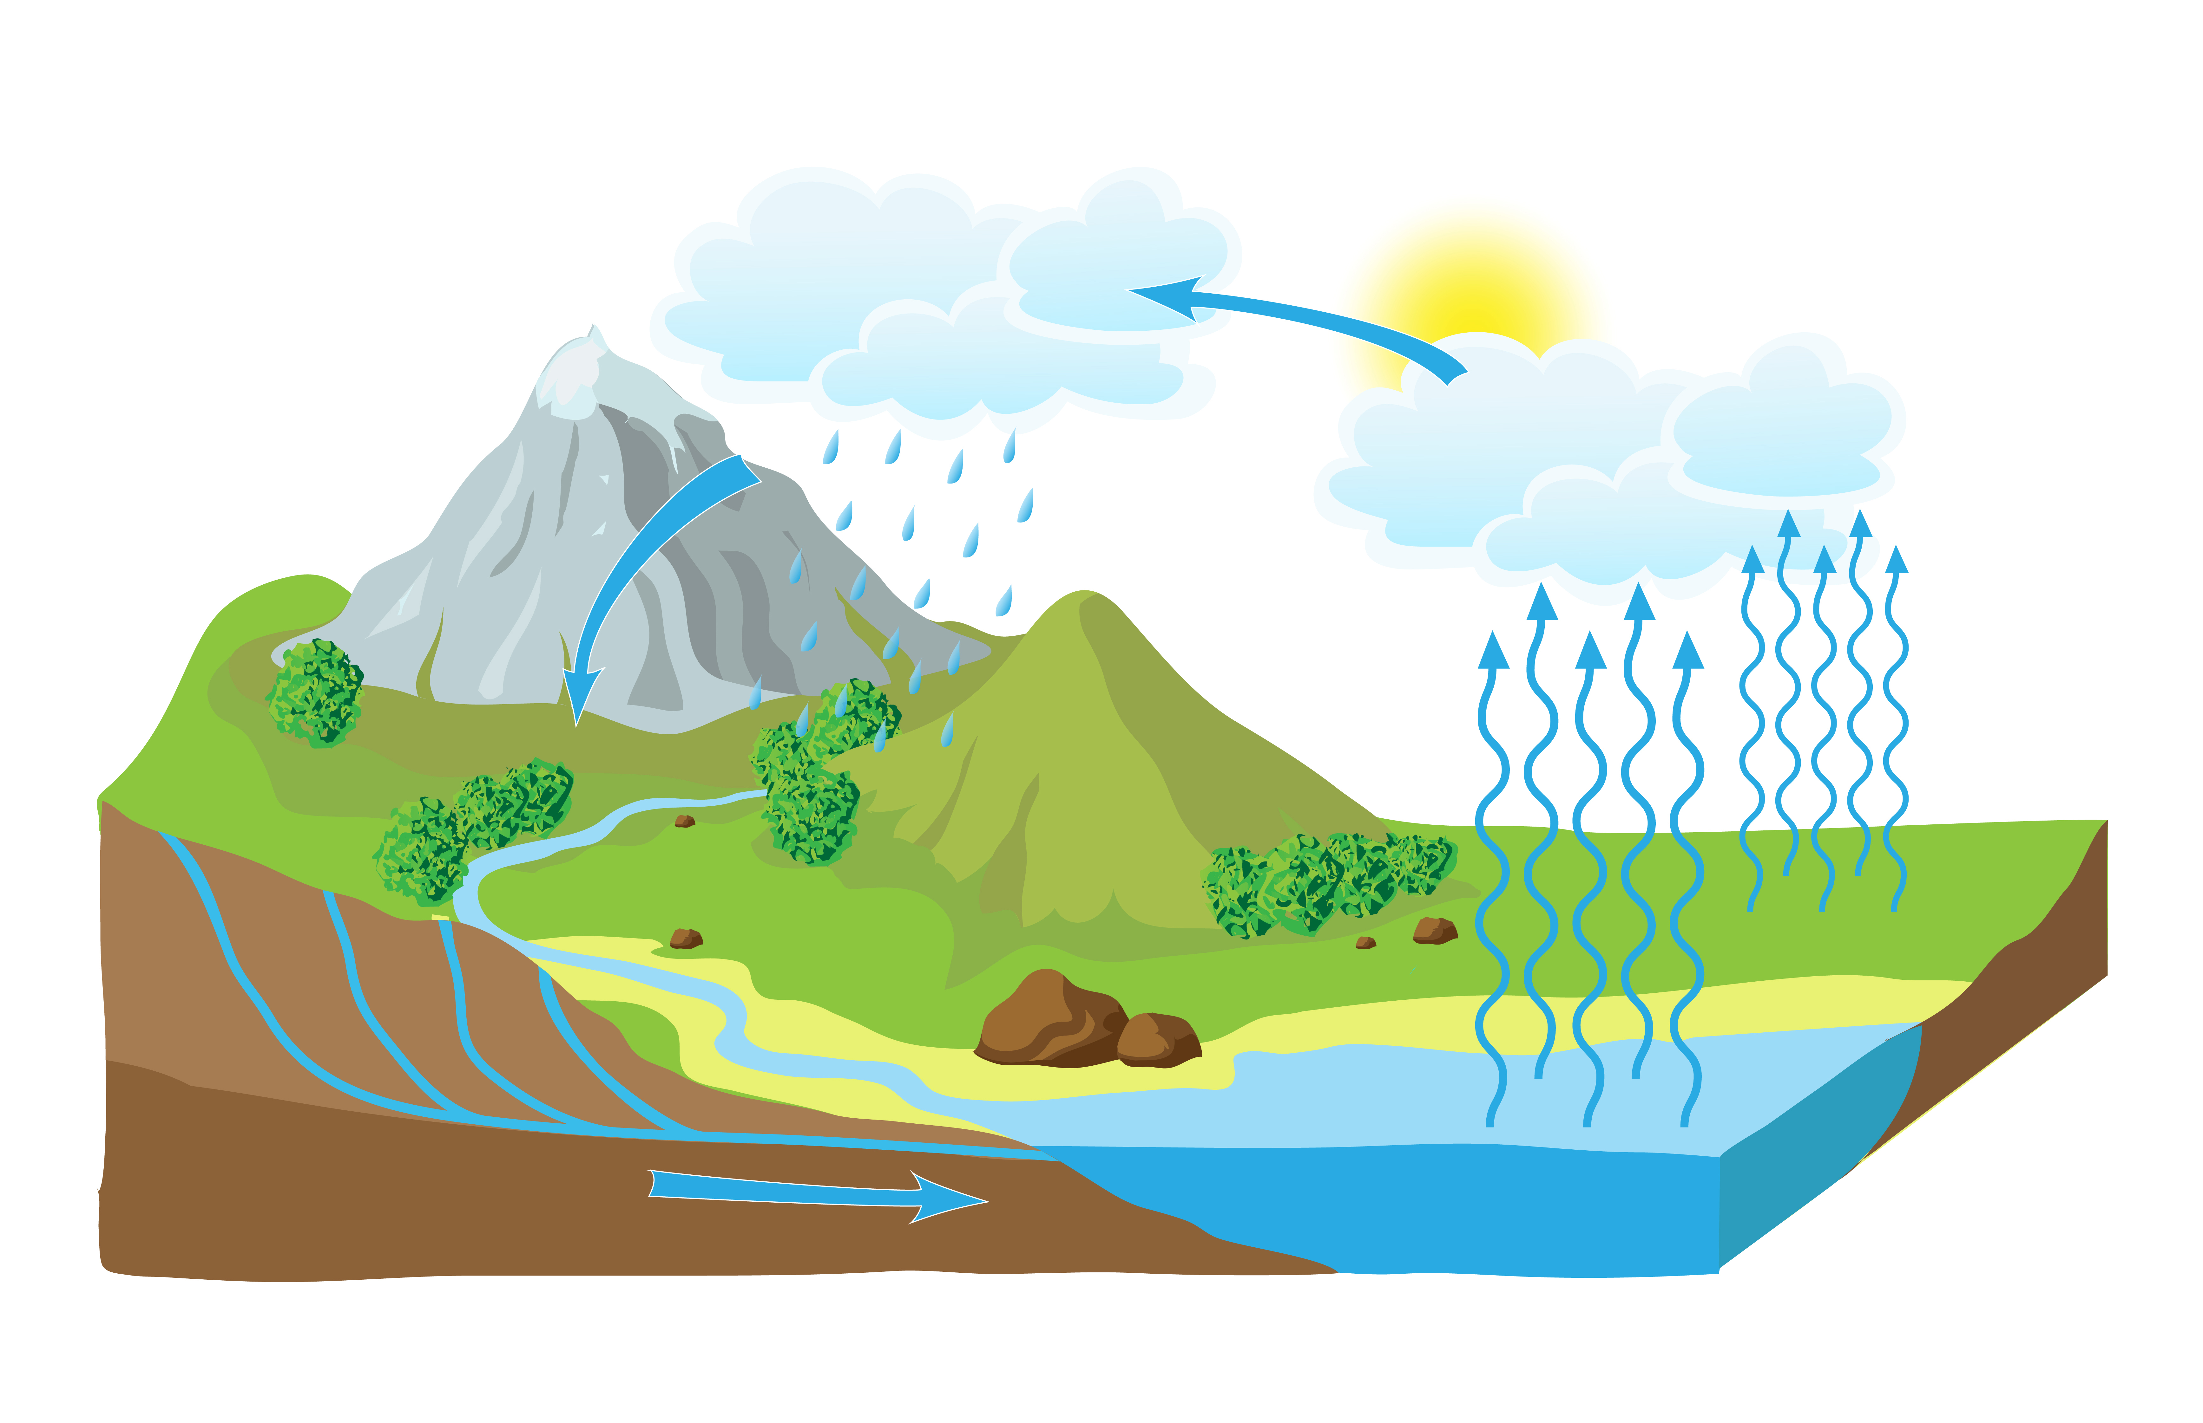
Water Energy
What is Water energy?
Water energy is a kind of energy which is created by moving water.
Water energy comes indirectly from solar energy. The sun heats the surface of oceans and lakes causing water to evaporate. This water then turns into clouds and falls as rain which feeds streams and rivers across the world. The energy in the water as it travels to the sea can be used to produce electricity. This is done by driving water through turbines which drive electric generators.

Slide 2
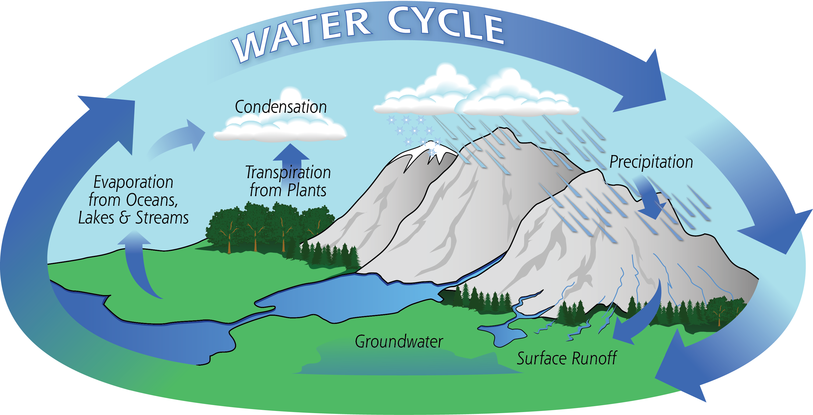
The Water Cycle

Slide 3
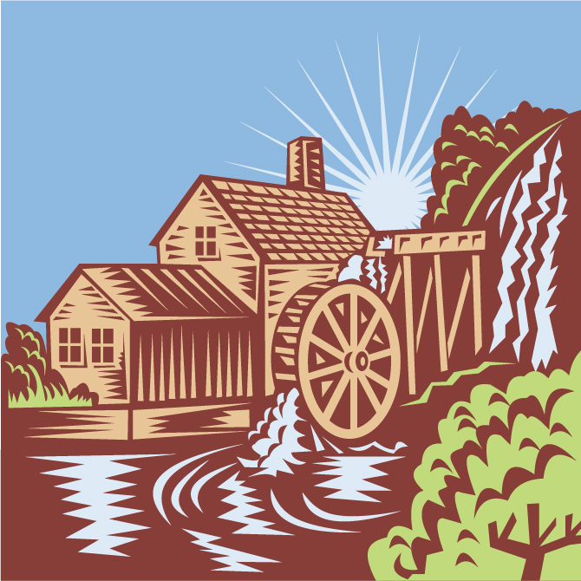
History of Water Energy
People have used water energy for over 2,000 years from when the Ancient Greeks and Romans used water wheels in mills to grind wheat into flour. About 200 years ago, there were 30,000 water mills in the UK.
These mills were used to create energy for all sorts of machines. Today we use water energy to create electricity. This is known as hydroelectricity.

Slide 4
History of Water Energy
Investigate examples of water mills in Wales.
Where is / was the mill?
What was the mill used for?

Slide 5
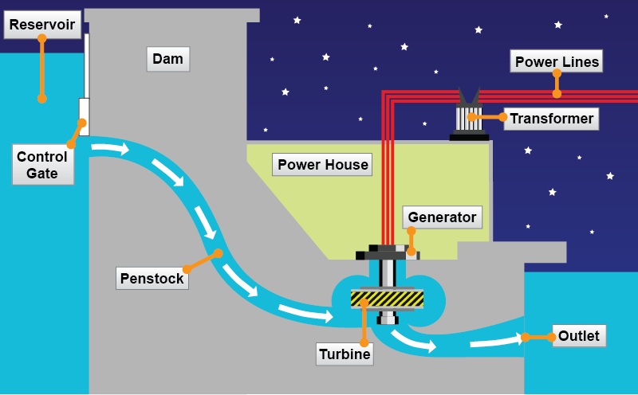
How does water energy work?
Water energy, or hydropower stations usually have large dams and water reservoirs. A reservoir is a store for energy, and it’s possible to control the energy produced by controlling how and when the water leaves the reservoir. The process is just like turning a tap on and off!

Slide 6
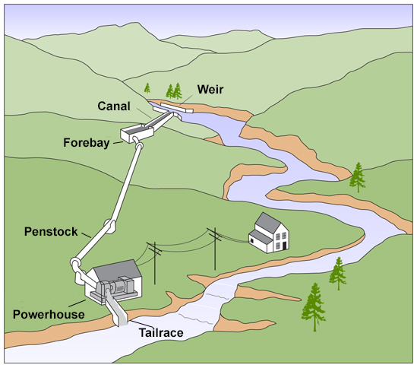
How does water energy work?
A dam is not needed at smaller power stations. Water is diverted from a river and re-directed along a canal to a turbine before re-joining the river.

Slide 7
Advantages of Water Energy
Water energy is a source of renewable energy which means it will never run out.
Water energy does not create waste or pollution and so does not impact on the climate.
Water energy stations can last up to 100 years.
Building dams could help to control flooding.
Discuss the advantages of water energy with your partner and put them in order to show the best advantage through to the worst advantage.
Water can be stored in reservoirs so that electricity can be produced when it is needed.

Slide 8
Advantages of Water Energy
Discuss the advantages of water energy with your partner and put them in order to show the best advantage through to the worst advantage.
Worst Best

Slide 9
Disadvantages of Water Energy
Finding an appropriate site for a water power station could be difficult in the UK as all the best locations are already being used. There are, however, plenty of places where small power stations could be developed.
Building large dams to create water reservoirs for large water energy power stations affects the local environment and local people. This means that great care must be taken when choosing locations to ensure the least negative effects possible.
Discuss the disadvantages of water energy with your partner and put then in order to show the biggest disadvantage through to the smallest disadvantage.
Fish can be affected if they are unable to swim past the power stations. Fish “ladders” are often built to allow fish to continue their journey up and down the river.

Slide 10
Disadvantages of Water Energy
Discuss the disadvantages of water energy with your partner and put then in order to show the biggest disadvantage through to the smallest disadvantage.
Smallest Biggest

Slide 11

In small groups, investigate the history of Tryweryn and the Electric Mountain at Dinorwig.
Tryweryn
http://www.llgc.org.uk/ymgyrchu/Dwr/Tryweryn/index-e.htm
http://www.mediaandmemory.co.uk/themes/tryweryn.php
Electric Mountain at Dinorwig
http://www.electricmountain.co.uk/History
Discuss and compare the two locations and note their effect on the environment.

Slide 12
Electric Mountain
at Dinorwig
Tryweryn

Slide 13
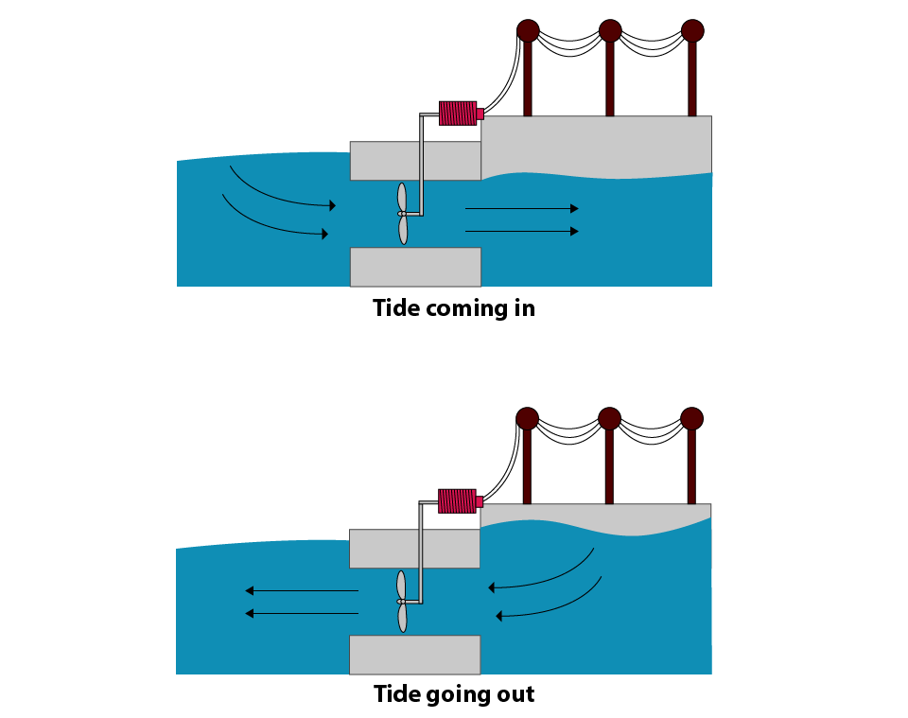
Tidal Energy
Tidal energy is created due to the gravitational pull of the moon, the sun and the rotation of the Earth.
As a result of these tidal forces, water movement can be used to create electricity.
This tidal electricity generation works as the tide comes in and again when it goes out. The turbines are driven by the power of the sea in both directions.
It is possible to predict tidal energy which is different to wind and solar energy. This makes tidal energy more reliable.

Slide 14
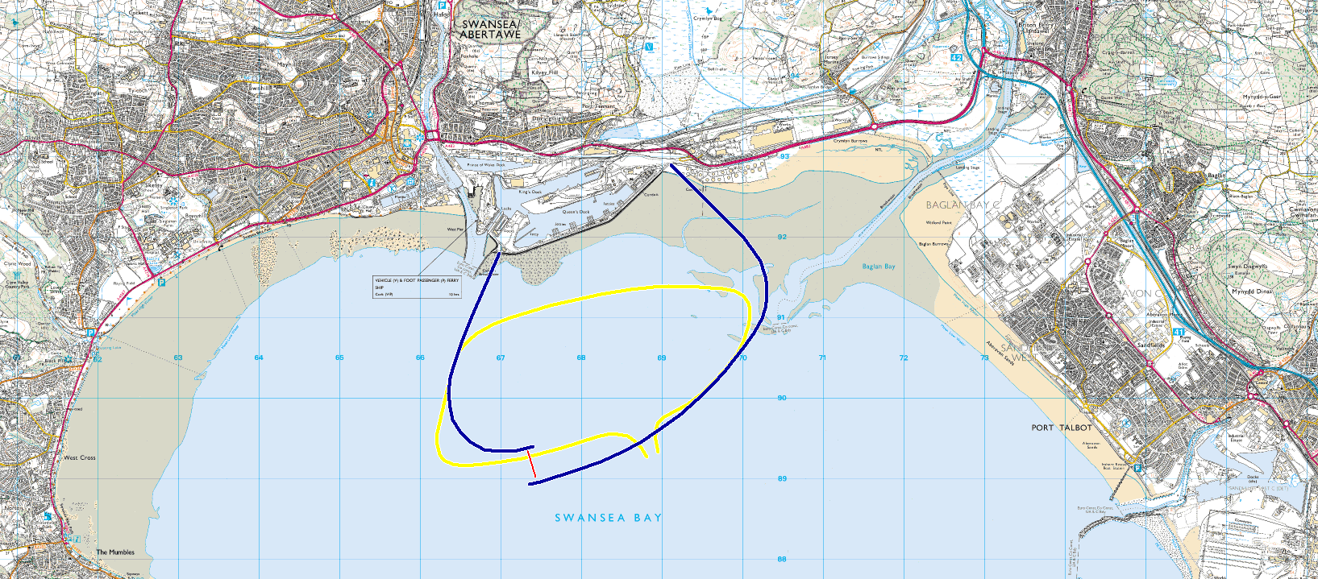
Tidal Energy in Wales
There is currently a tidal breakwater being built in Wales. The Swansea Bay Tidal Lagoon will be the first purpose built tidal lagoon in the world. It will create renewable energy for over 155,000 homes for over 120 years.
Go to the website to learn more about the project
http://www.tidallagoonswanseabay.com/

Slide 15
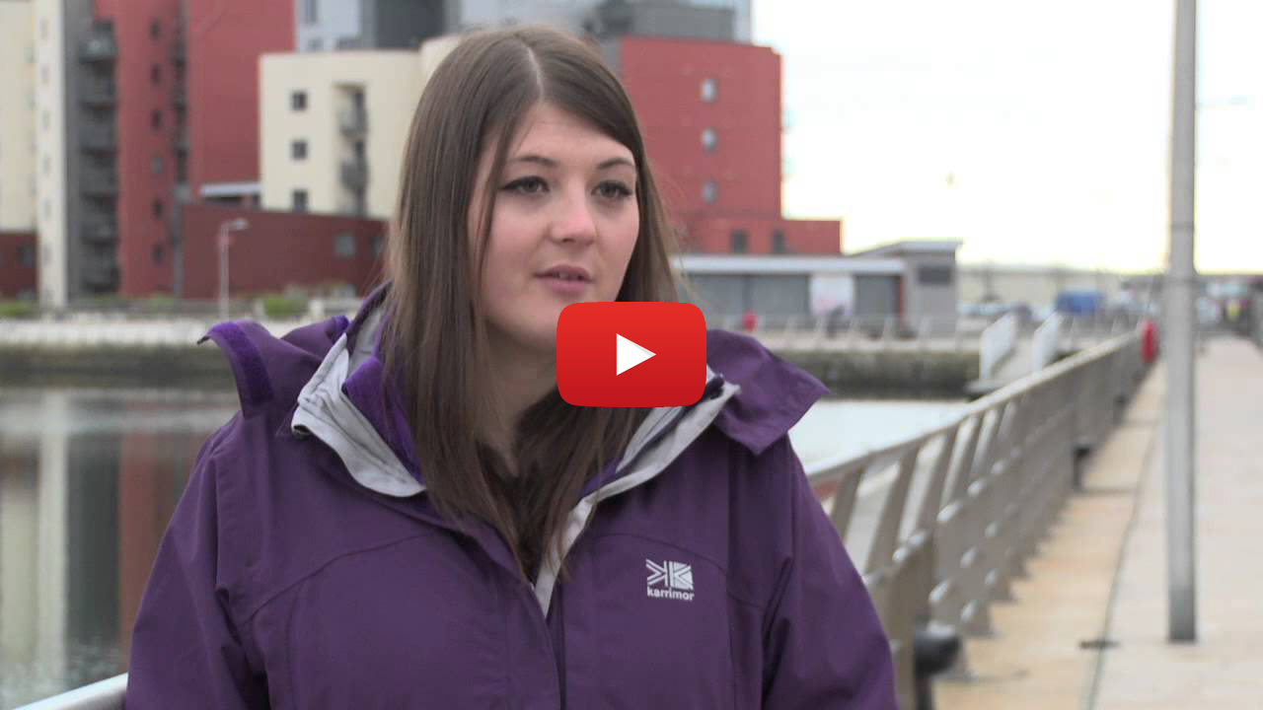
Tidal Energy in Wales
The Tidal Lagoon: https://www.youtube.com/watch?v=JUJNbUYDIYs

Slide 16
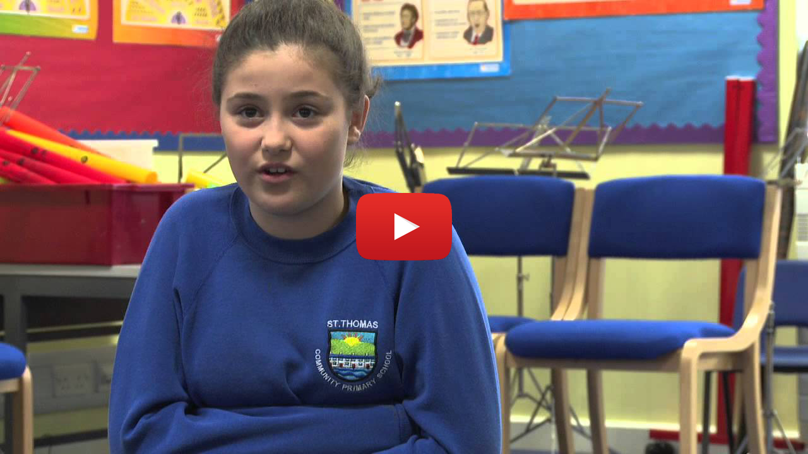
Tidal Energy in Wales
Opinions on the Tidal Lagoon: https://www.youtube.com/watch?v=gRYHXxXINxE

Slide 17

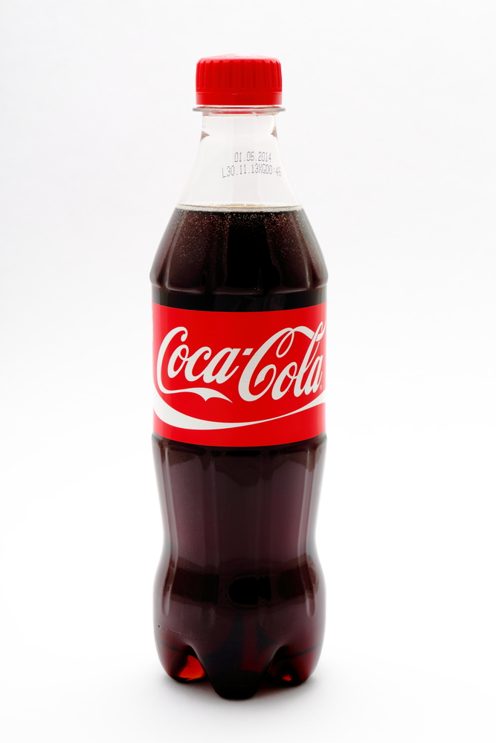

Task – Now that you have learnt about water energy, work in groups to design a water turbine that can lift weights.
You can use everyday household items to create your turbine including:
https://www.youtube.com/watch?v=x8xow_R0YRI

Slide 18
Record the stages of building your turbine here and evaluate your final product.
Stage 1
Stage 2
Stage 3
Stage 4
Stage 5
Stage 6
Evaluate

